Slide 1

Numerical Algorithms for Machine
Learning
Session 1
Computer arithmetic: the IEEE 754 Standard
Dr. Ahmed Abdelreheem

Slide 2
1
Introduction: from real numbers to computer numbers
2
Floating Point Arithmetic
3
IEEE Floating Point Essentials
Content
4
Precision, Machine Epsilon and Ulp
5
The Single Format and The Double Format
6
Rounding, absorption and cancellation errors
7
Accuracy and precision in numerical computations
8
A curiosity: The Gentleman-Marovitch Code
A Case Study with Summation Algorithms : the Pichat’s Algorithm
9

Slide 3
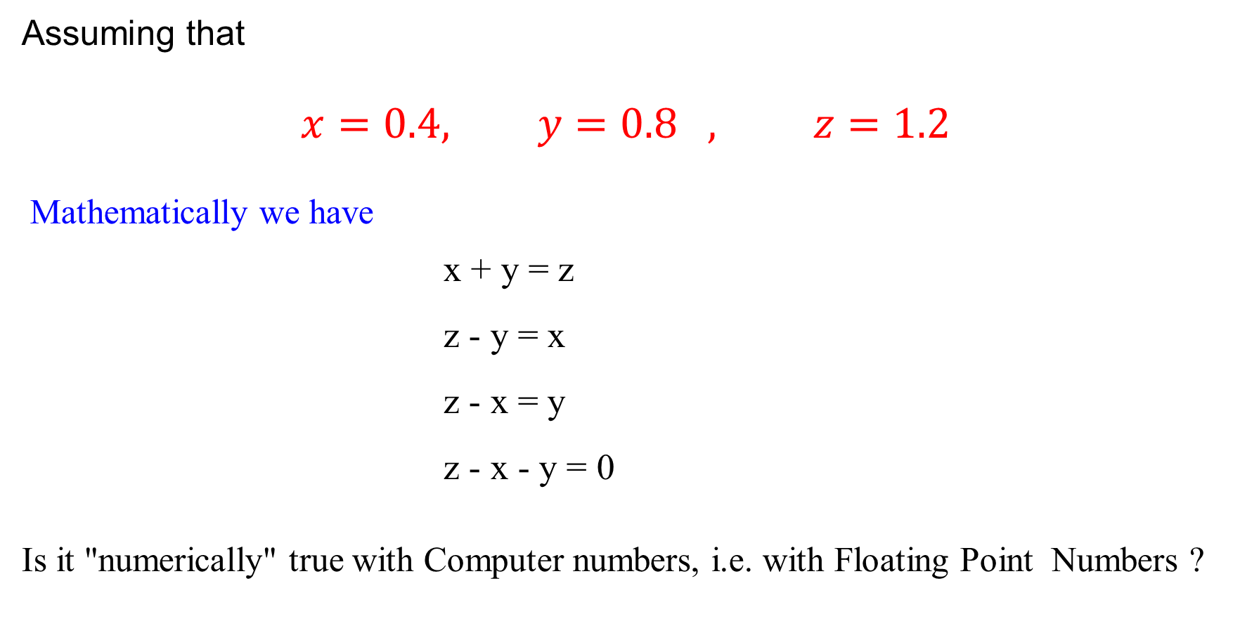
Why we study Floating-Point Representation and Arithmetic?
Assuming that
$$x=0.4, y=0.8 , z=1.2$$
Mathematically we have
x + y = z
z - y = x
z - x = y
z - x - y = 0
Is it "numerically" true with Computer numbers, i.e. with Floating Point Numbers ?
“the computer calculated it,
so it must be right”.

Slide 4
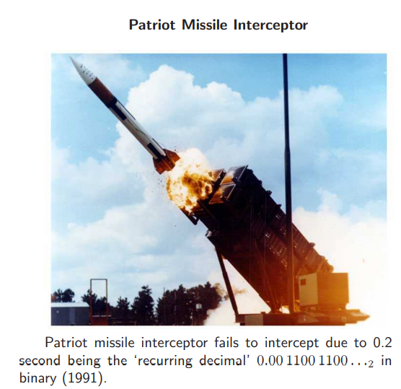
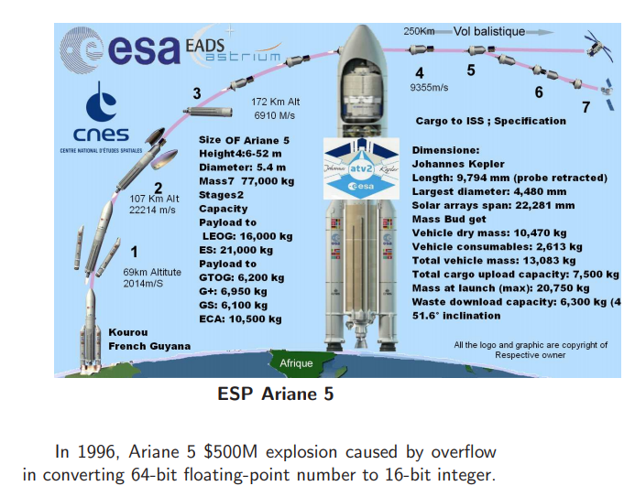
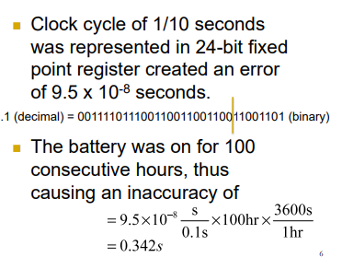
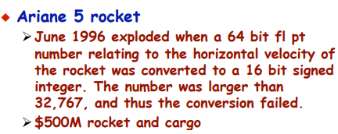

Slide 5

We need to understand how these numbers are represented inside our computers !

Slide 6
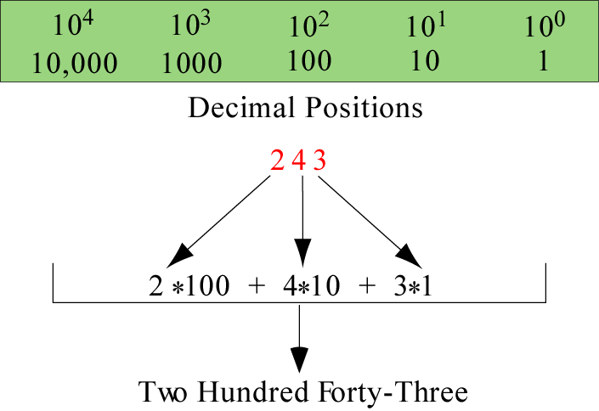
Number Representation
Decimal system

Slide 7
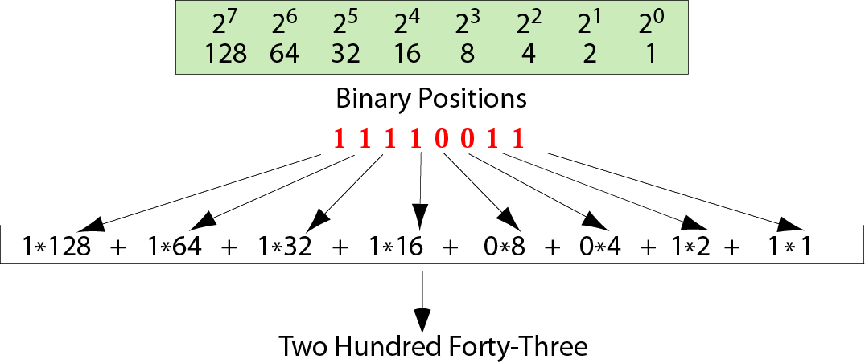
Number Representation
Binary system

Slide 8
Number Representation
Converting Base-2 to Base-10
(1
0
0
1
1)
Exponent:
2⁴
2³
2²
2¹
2⁰
16
0
0
2
1
Calculation:
+
+
+
+
=
(19)₁₀

Slide 9
Number Representation
Example of storing unsigned integers in
two different computers
Decimal ------------
7
234
258
24,760
1,245,678
8-bit allocation
------------
00000111
11101010
overflow
overflow
overflow
16-bit allocation
------------------------------
0000000000000111
0000000011101010
0000000100000010
0110000010111000
overflow

Slide 10
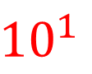
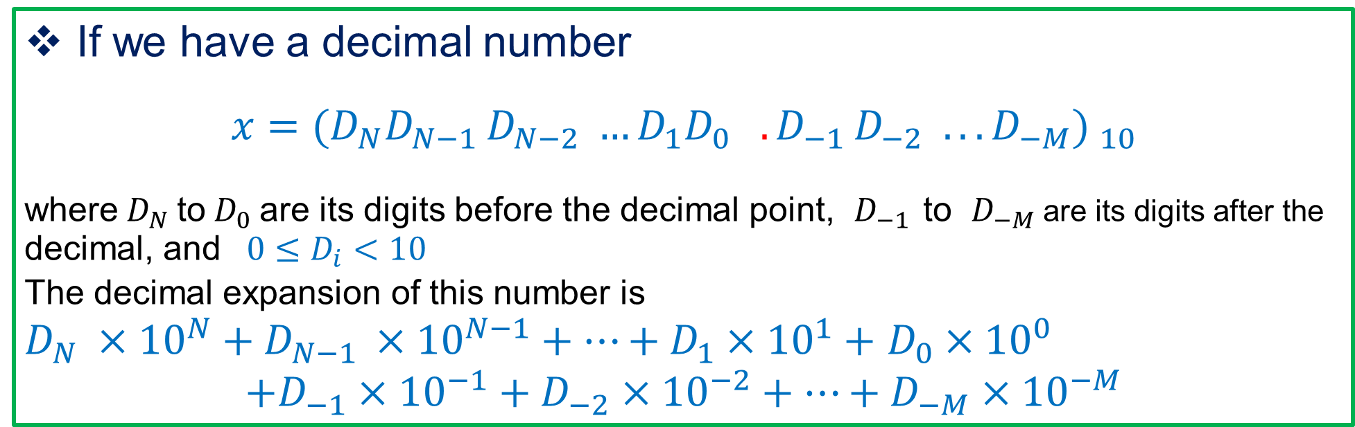
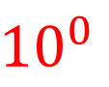
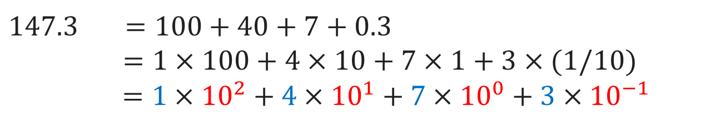
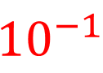
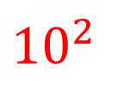
Base-10 Numbers Representation
$${10}^{2}$$
$${10}^{1}$$
$${10}^{0}$$
$${10}^{−1}$$
Show the decimal expansion for 147.3
.
1
4
7
3
$$147.3 =100+40+7+0.3$$
$$=1×100+4×10+7×1+3×(1/10)$$
$$=1×{10}^{2}+4×{10}^{1}+7×{10}^{0}+3×{10}^{−1}$$
If we have a decimal number
$$x=(D_{N}D_{N−1 }D_{N−2} …D_{1}D_{0} .D_{−1 }D_{−2} . ..D_{−M}) _{10}$$
where$D_{N}$to$D_{0}$are its digits before the decimal point, $D_{−1 }$to $D_{−M}$are its digits after the decimal, and ${0≤D}_{i}<10$
The decimal expansion of this number is
$D_{N} ×{10}^{N}+D_{N−1 }×{10}^{N−1}+…+D_{1}×{10}^{1}+$ $D_{0}×{10}^{0}$
$$+D_{−1}×{10}^{−1}+D_{−2}×{10}^{−2}+…+D_{−M}×{10}^{−M}$$

Slide 11
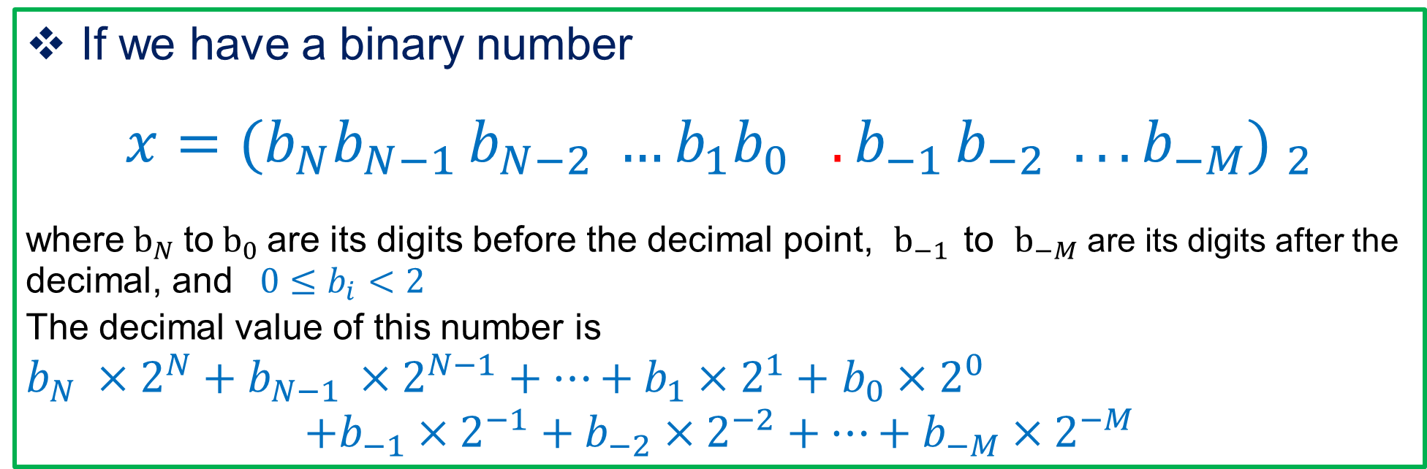
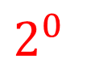
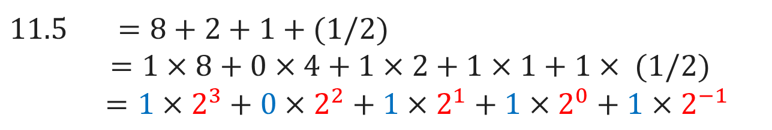
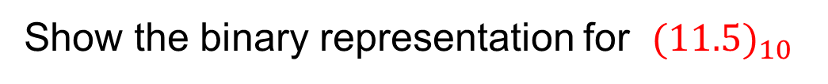
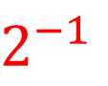
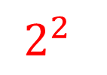
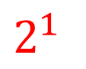
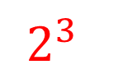
Base-2 Numbers Representation
$$2^{3}$$
$$2^{2}$$
$$2^{1}$$
$$2^{0}$$
$$2^{−1}$$
Show the binary representation for ${(11.5)}_{10}$
.
1
0
1
1
1
$$11.5 =8+2+1+(1/2)$$
$$=1×8+0×4+1×2+1×1+1× (1/2)$$
$$=1×2^{3}+0×2^{2}+1×2^{1}+1×2^{0}+1×2^{−1}$$
If we have a binary number
$$x=(b_{N}b_{N−1 }b_{N−2} …b_{1}b_{0} .b_{−1 }b_{−2} . ..b_{−M}) _{2}$$
where$b_{N}$to$b_{0}$are its digits before the decimal point, $b_{−1 }$to $b_{−M}$are its digits after the decimal, and ${0≤b}_{i}<2$
The decimal value of this number is
$b_{N} ×2^{N}+b_{N−1 }×2^{N−1}+…+b_{1}×2^{1}+$ $b_{0}×2^{0}$
$$+b_{−1}×2^{−1}+b_{−2}×2^{−2}+…+b_{−M}×2^{−M}$$

Slide 12
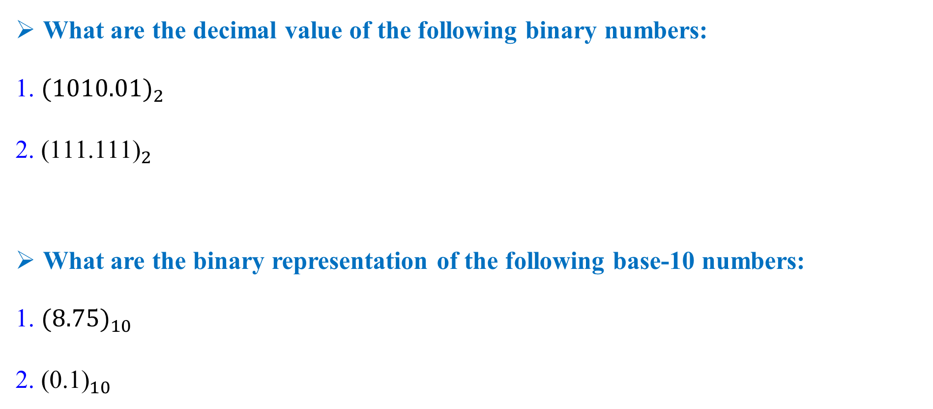
Exercise
What are the decimal value of the following binary numbers:
1. ${(1010.01)}_{2}$
2. ${\text{(111.111)}}_{2}$
What are the binary representation of the following base-10 numbers:
1. ${(8.75)}_{10}$
2. ${\text{(0.1)}}_{10}$

Slide 13


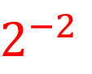
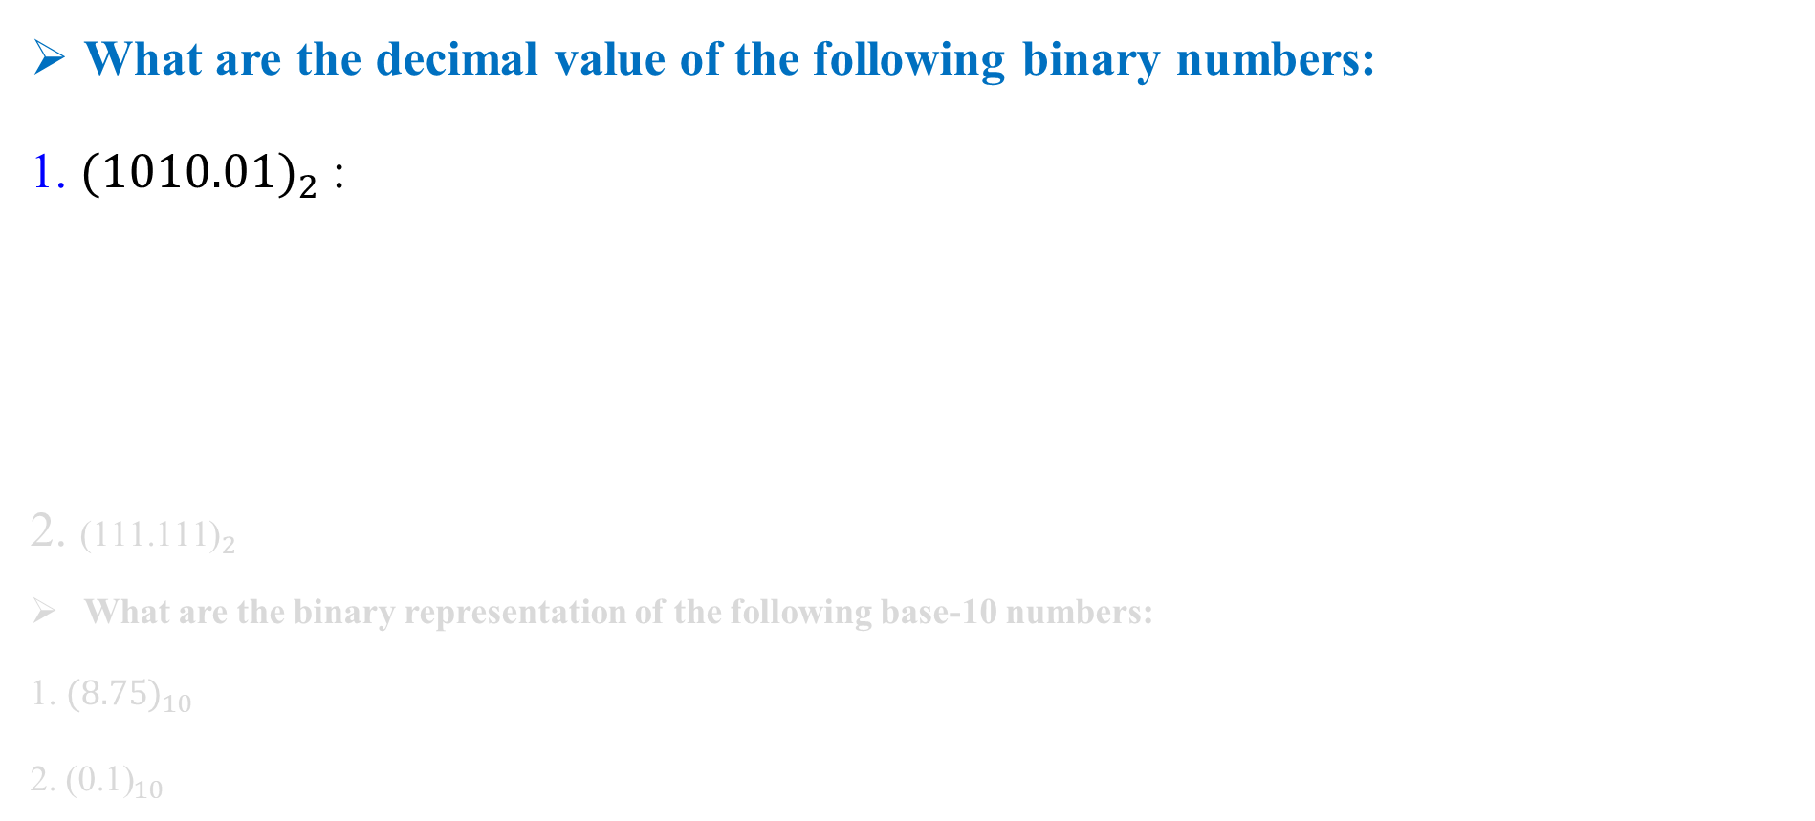



Exercise
What are the decimal value of the following binary numbers:
1. ${(1010.01)}_{2}$ :
2. ${\text{(111.111)}}_{2}$
What are the binary representation of the following base-10 numbers:
1. ${(8.75)}_{10}$
2. ${\text{(0.1)}}_{10}$
$$2^{3}$$
$$2^{2}$$
$$2^{1}$$
$$2^{0}$$
$$2^{−1}$$
$$2^{−2}$$
.
1
0
1
0
0
1
8 + 0 + 2 + 0 . 0 + 1/4 = 10.25

Slide 14



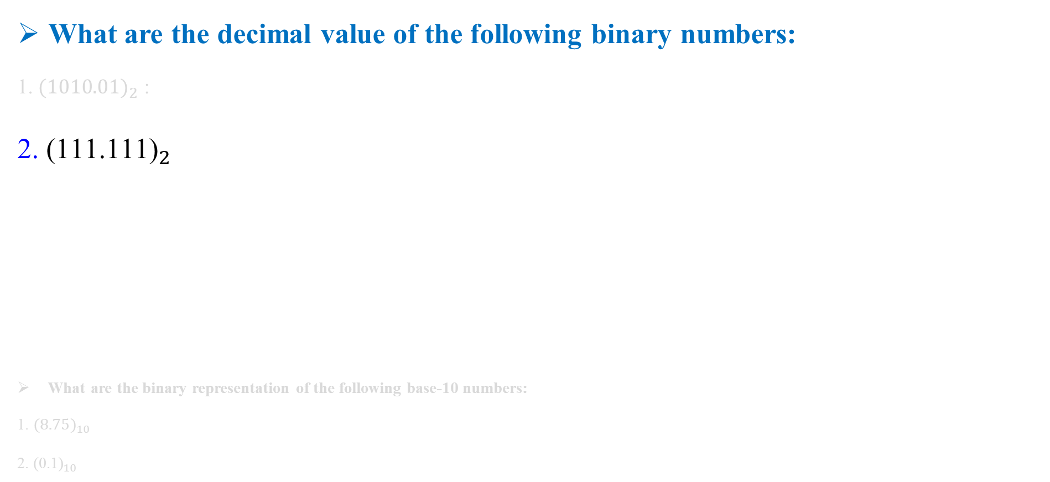

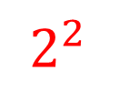
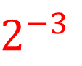
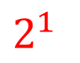
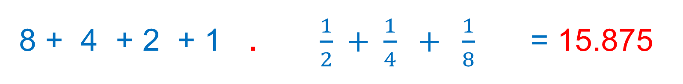
Exercise
What are the decimal value of the following binary numbers:
1. ${(1010.01)}_{2}$ :
2. ${\text{(111.111)}}_{2}$
What are the binary representation of the following base-10 numbers:
1. ${(8.75)}_{10}$
2. ${\text{(0.1)}}_{10}$
$$2^{3}$$
$$2^{2}$$
$$2^{1}$$
$$2^{0}$$
$$2^{−1}$$
$$2^{−2}$$
$$2^{−3}$$
.
1
1
1
1
1
1
1
8 + 4 + 2 + 1 . $\frac{1}{2} + \frac{1}{4} + \frac{1}{8}$= 15.875

Slide 15
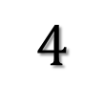
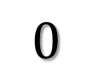

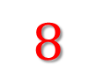
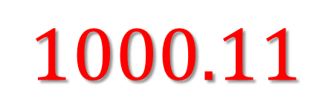
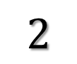
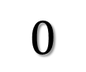
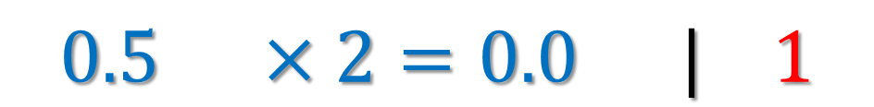

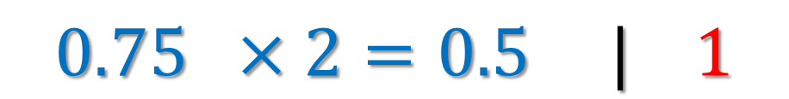
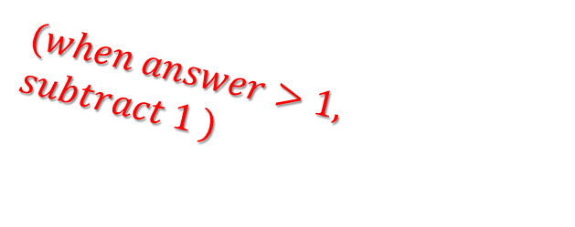
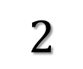
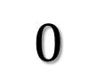
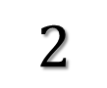
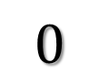

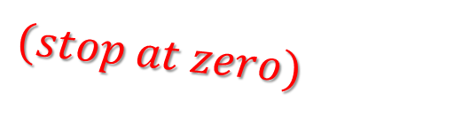
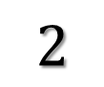
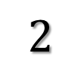

Exercise
Decimal Binary
$$8.75$$
$$2$$
$$8$$
$$0$$
$$0.75 ×2=0.5 | 1$$
$$2$$
$$4$$
$$0$$
$$0.5 ×2=0.0 | 1$$
$$2$$
$$2$$
$$0$$
$(when answer>1,$ $subtract 1 )$
$$0$$
$$2$$
$$1$$
$$1$$
$$(stop at zero)$$
$$0$$
$$1000.11$$

Slide 16
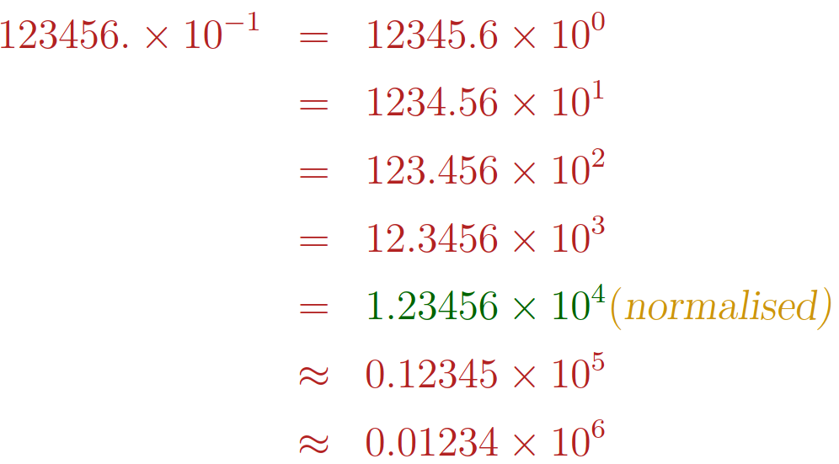
Scientific Notation
Scientific notation is a way to make these numbers easier to work with. In scientific notation, you move the decimal place until you have a number between 1 and 10

Slide 17
Scientific Notation (in Decimal)
exponent
mantissa
6.02₁₀ x 10²³
decimal point
radix (base)
Normalized form: no leadings 0s (exactly one digit to left of decimal point)
Alternatives to representing 1/1,000,000,000
Normalized: 1.0 x 10⁻⁹
Not normalized: 0.1 x 10⁻⁸, 10.0 x 10⁻¹⁰

Slide 18
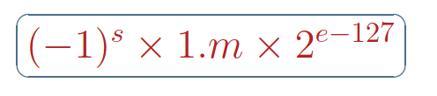
Scientific Notation (in Binary)
mantissa
exponent
1.0_{two} x 2⁻¹
“binary point”
radix (base)
Computer arithmetic that supports it called floating point, because it represents numbers where binary point is not fixed, as it is for integers

Slide 19
IEEE Floating Point Arithmetic
Numerical computing is a vital part of the modern scientific infrastructure. Almost all numerical computing uses floating point arithmetic, and almost every modern computer implements the IEEE binary floating-point standard
Floating point computation was in standard use by the mid 1950s. During the subsequent two decades, each computer manufacturer developed its own floating point system, leading to much inconsistency in how one program might behave on different machines. For example, the IBM 360/370 series, which dominated computing during the 1960s and 1970s, used a hexadecimal system (base 16)
Consequently, it was very difficult to write portable software that would work properly on all machines. Programmers needed to be aware of various difficulties that might arise on different machines and attempt to forestall them.
In the past every manufacturer produced their own ﬂoating point hardware and ﬂoating point programs gave diﬀerent answers. IEEE standardization ﬁxed this.
In 1985, the IEEE (Institute for Electrical and Electronic Engineers) published a report called Binary Floating Point Arithmetic Standard 754

Slide 20
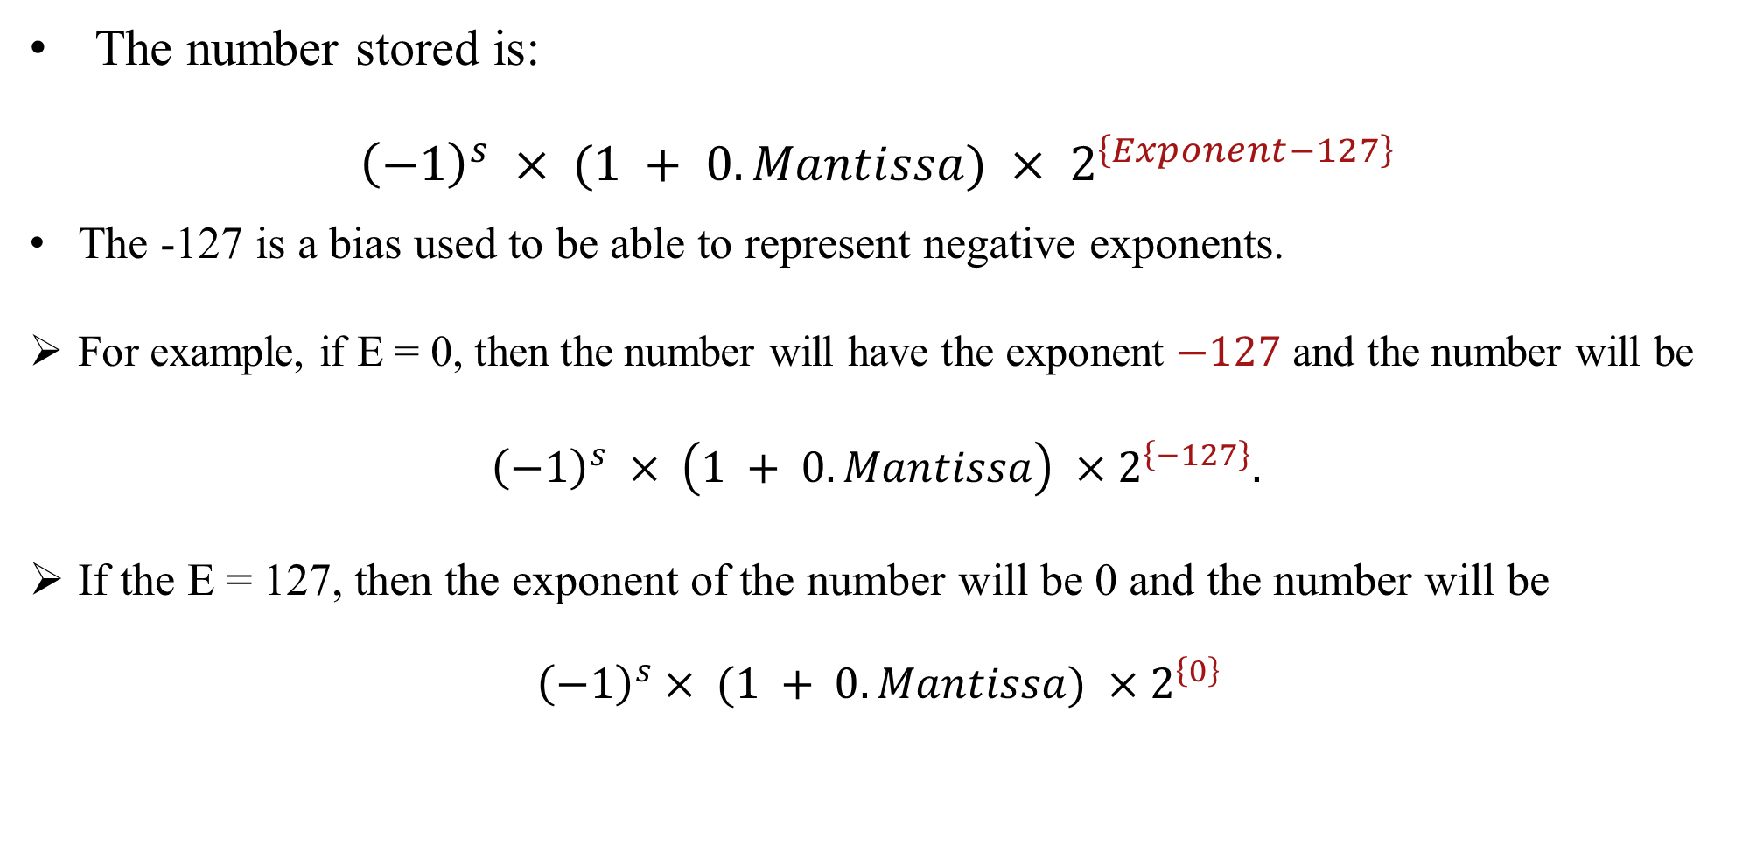
Floating Point Arithmetic IEEE Standard 754
The number stored is:
$${\left(−1\right)}^{s} × (1 + 0.Mantissa) × 2^{\left\{Exponent−127\right\}}$$
The -127 is a bias used to be able to represent negative exponents.
For example, if E = 0, then the number will have the exponent $−127$ and the number will be
${\left(−1\right)}^{s} × \left(1 + 0.Mantissa\right) ×2^{\left\{−127\right\}}.$
If the E = 127, then the exponent of the number will be 0 and the number will be
$${\left(−1\right)}^{s}× (1 + 0.Mantissa) ×2^{\left\{0\right\}}$$

Slide 21
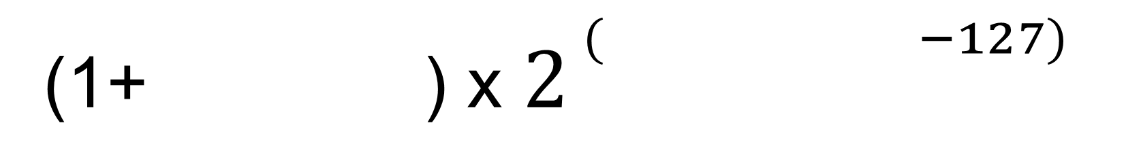
Floating Point Arithmetic IEEE Standard 754
(Single Precision)
32-bit
1-bit
Sign
8-bit
Exponent
23-bit
Mantissa
(1+ ) x $2^{ ^{( −127)}}$
Exponent
Sign
Mantissa

Slide 22
Floating Point Arithmetic IEEE Standard 754
(Single Precision)
32-bit
0
10000011
00010010000000000000000
1-bit
Sign
8-bit
Exponent
23-bit
Mantissa
0 = Positive
1 = Negative

Slide 23
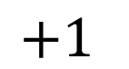






Floating Point Arithmetic IEEE Standard 754
(Single Precision)
32-bit
0
10000011
00010010000000000000000
8-bit
Exponent
23-bit
Mantissa
1-bit
Sign
$$2^{7}$$
$$2^{1}$$
$$2^{0}$$
1
0
0
0
0
0
1
1
$$=131$$
$$128$$
$$+2$$
$$+1$$

Slide 24







Floating Point Arithmetic IEEE Standard 754
(Single Precision)
32-bit
0
10000011
00010010000000000000000
8-bit
Exponent
23-bit
Mantissa
1-bit
Sign
$$2^{−1}$$
$$2^{−4}$$
$$2^{−7}$$
$$⋯$$
0
0
0
1
0
0
1
0
$$\frac{1}{16}$$
+ $\frac{1}{128}$
$$=\frac{9}{128}$$

Slide 25




Floating Point Arithmetic IEEE Standard 754
(Single Precision)
32-bit
0
10000011
00010010000000000000000
1-bit
Sign
8-bit
Exponent
23-bit
Mantissa
(1+ ) x $2^{ ^{( −127)}}$
Exponent
Sign
Mantissa
$$2^{4}$$
$$=\frac{137}{128}\text{x}16=\frac{2192}{128} =17.125$$
$$\frac{137}{128}$$
x
+

Slide 26

















Floating Point Arithmetic IEEE Standard 754
(Single Precision)
Decimal Binary
$$17.125$$
$$2$$
$$17$$
$$1$$
$$0.125 ×2=0.25 | 0$$
$$2$$
$$8$$
$$0$$
$$2$$
$$0.25 ×2=0. 5 | 0$$
$$4$$
$$0$$
$$2$$
$$2$$
$$0$$
$$0.5 ×2=1 | 1$$
$$2$$
$$1$$
$$1$$
$(when answer>1,$ $subtract 1 )$
$$0$$
$$0$$
$$(stop at zero)$$

Slide 27


















Floating Point Arithmetic IEEE Standard 754
(Single Precision)
Decimal Binary
$$2$$
$$17$$
$$1$$
$$17.125$$
$$8$$
$$0.125 ×2=0.25 | 0$$
$$2$$
$$0$$
$$0.25 ×2=0. 5 | 0$$
$$2$$
$$4$$
$$0$$
$$0.5 ×2=1 | 1$$
$$2$$
$$2$$
$$0$$
$$0$$
$$2$$
$$1$$
$$1$$
$$0$$
$$10001.001$$

Slide 28






Floating Point Arithmetic IEEE Standard 754
(Single Precision)
$$10001.001$$
$$17.125=$$
.
$${×2}^{0}$$
1
0
0
0
1
0
0
1
$$shift the decimal$$
.
$${×2}^{1}$$
1
0
0
0
1
0
0
1
.
$${×2}^{4}$$
1
0
0
0
1
0
0
1

Slide 29


Floating Point Arithmetic IEEE Standard 754
(Single Precision)

Slide 30


Floating Point Arithmetic IEEE Standard 754
(Single Precision)
The smallest positive normalized number that can be stored is represented by
The largest normalized number (equivalently, the largest finite number) is represented by

Slide 31


Floating Point Arithmetic IEEE Standard 754
(Single Precision)
$$10001.001$$
$$17.125=$$
Exponent
.
$${×2}^{4}$$
1
0
0
0
1
0
0
1
Mantissa
$$10000011$$
Convert the exponent to binary : 4 + 127 = 131
0
10000011
00010010000000000000000
Sign
Exponent
Mantissa

Slide 32

Exercise
Convert to the equivalent Floating Point Arithmetic IEEE Standard 754 (Single Format)
$+105.625$
$−105.625$
0.09375
$+2.7$
-123.3 (Homework)

Slide 33


















Exercise
Decimal Binary
$$2$$
$$105$$
$$1$$
$$105.625$$
$$2$$
$5$2
$$0$$
$$0.625 ×2=0.25 | 1$$
$$2$$
$$26$$
$$0$$
$$2$$
$$13$$
1
$$0.25 ×2 =0.5 | 0$$
$$2$$
$$6$$
0
$$0.5 ×2 =0.0 | 1$$
2
3
1
2
1
1
$1101001.1$01
0

Slide 34






Exercise
$$1101001.1\text{01}$$
$$105.625=$$
.
$${×2}^{0}$$
1
1
0
1
0
0
1
1
0
1
$$shift the decimal$$
.
$${×2}^{6}$$
1
1
0
1
0
0
1
0
0
1
$$1.1010011\text{01}×2^{6}=1.1010011\text{01}×2^{133−127}$$

Slide 35

Exercise

Slide 36

Exercise

Slide 37

Floating Point Arithmetic IEEE Standard 754
(Double Precision)
64-bit
1-bit
Sign
11-bit
Exponent
52-bit
Mantissa
(1+ ) x $2^{ ^{( −1023)}}$
Exponent
Sign
Mantissa

Slide 38

Floating Point Arithmetic IEEE Standard 754
(Double Precision)

Slide 39


Floating Point Arithmetic IEEE Standard 754
(Double Precision)
The smallest positive normalized number that can be stored is represented by
The largest normalized number (equivalently, the largest finite number) is represented by

Slide 40

Range of IEEE Floating Point Formats

Slide 41
The Extended Format (Homework)
Program 1: Convert a real value to its floating point representation
Program 2: Convert a floating point representation to its real value

Slide 42

Precision, Machine Epsilon
we use the notation $p (precision)$to denote the number of bits in the significand and e (machine epsilon) to mean the gap between 1 and the next larger floating point number. The precision of the IEEE single format is $p = 24$(including the hidden bit); for the double format it is $p = 53$(again, including the hidden bit). When we speak of single precision, we mean the precision of the IEEE single format $(p = 24);$likewise double precision means the precision of the IEEE double format (p = 53)
The first single format number larger than $1$ is $1+2^{−23}$
The first double format number larger than $1$ is $1+2^{−52}$

Slide 43

Significant Digits
The single precision $p = 24$corresponds to approximately $7$ significant decimal digits, since
$$2^{−24}≈{10}^{−7}$$
$$\log_{10}{{(2}^{24})≈7}$$
The double precision $p = 53$corresponds to approximately $16$ significant decimal digits

Slide 44


Machine Epsilon

Slide 45


Precision, Machine Epsilon
Precision ($p$): the number of bits in the mantissa + 1
Returning again to the IEEE formats, if $x$ is in the normalized range, with
$$x=±\left(1.b_{1}b_{2 } …b_{p−1}b_{p }b_{p+1} . ..\right) _{2} ×2^{E}$$
the absolute rounding error associated with x is less than the gap between $x_{−}$ and $x_{+}$,
regardless of the rounding mode, The relative rounding error associated with a nonzero number $x$ is defined by
$$relerr(x) =\left|δ\right|$$
$$δ=\frac{round(x)}{x}−1=\frac{round\left(x\right)−x}{x}$$
$$relerr\left(x\right)=\left|δ\right|=\frac{\left|round\left(x\right)−x\right|}{\left|x\right|}<\frac{2^{−(p−1)}×2^{E}}{2^{E}}=2^{−(p−1)}=ε$$
Machine Epsilon

Slide 46

Precision, Machine Epsilon

Slide 47


Machine Epsilon (in Python)

Slide 48




(IEEE Rounding)
$$x=±\left(b_{0}.b_{1}b_{2 } …b_{p−1}\right) _{2} ×2^{E}$$
$$where p is the precision of the floating-point system with, for normalized numbers$$
$$b_{0}=1, E_{min}≤E ≤E_{max}$$
We say that a real number $x$ is in the normalized range of the floating point system if
$$N_{min}≤\left|x\right| ≤N_{max}$$
Let us define $x_{−}$ to be the floating point number closest to $x$ that is less than or equal to $x$, and define $x_{+}$ to be the floating point number closest to $x$ that is greater than or equal to $x$.
For example, consider the toy floating point number system again. If $x = 1.7, thenx_{−}= 1.5 andx_{+}= 1.75$

Slide 49


(IEEE Rounding)
let x be a positive number in the normalized range, and write x in the normalized form
$$x=\left(1.b_{1}b_{2 } …b_{p−1}b_{p }b_{p+1} . ..\right) _{2} ×2^{E}$$
It follows that the closest floating point number less than or equal to $x$ is
$$x_{−}=\left(b_{0}.b_{1}b_{2 } …b_{p−1}\right) _{2} ×2^{E}$$
$$x_{+}=\left(b_{0}.b_{1}b_{2 } …b_{p−1}\right) _{2}+{(0.00 …01)}_{2} ×2^{E}$$
$$therefore also the next one that is bigger than x \left(which must lie between x_{−}and x_{+}\right).$$
$$Here the \text{1}in the increment is in the \left(p — l\right)th place after$$
$$the binary point, so the gap between x_{−}and{ x}_{+} is$$
$$2^{−(p−1)}×2^{E}$$
Note that this quantity is the same as ulp($x_{−}$)

Slide 50


Floating point operations
(IEEE Rounding)
(IEEE Rounding)
Round down (sometimes called round towards $−∞$) : $round\left(x\right)=x_{−}$
Round up (sometimes called round towards $∞$) : $round\left(x\right)=x_{+}$
Round towards zero: $round\left(x\right)=x_{−} if x>0;round\left(x\right)=x_{+} if x<0$
Round to nearest: $round\left(x\right)=x_{−} or x_{+}$ whichever is nearer to $x$ (unless $|x| > N_{max}$).
If $x$ is positive, then $x_{−}$ is between zero and $x$, so round down and round towards zero have the same effect. If $x$ is negative, then $x_{+}$ is between zero and $x$;, so round up and round towards zero have the same effect. In both cases, round towards zero simply requires truncating the binary expansion, unless $x$ is outside the normalized range. The rounding mode that is almost always used in practice is round to nearest.

Slide 51




Cancellation
Consider the two numbers
The first number, $x$ , is a 16-digit approximation to $π$, while the second number agrees with $π$ to only 12 digits. Their difference is
This difference is in the normalized range of the IEEE single format. However, if we compute the difference
$z = x — y$ in, (C, Python,…) program, using the single format to store the variables $x$ and y before doing the subtraction, and display the result to single precision,
we find that the result displayed for $z$ is

Slide 52


Cancellation
The reason is simple enough. The input numbers x and y are first converted from decimal to the single binary format; they are not exact floating point numbers, so the decimal to binary conversion requires some rounding. Because they agree to 12 digits, both x and y round to exactly the same single format number. Thus, all bits in their binary representation cancel when the subtraction is done; we say that we have a complete loss of accuracy in the computation $z = x — y.$
If we use the double format to store x and y and their difference z, and if we display the result to double precision, we find that z has the value
This agrees with the exact answer to about four digits, but what is the meaning of the other digits? The answer is that the result displayed is the correctly rounded difference of the double format representations of x and y
It is important to realize that in this case, we may ignore all but the first four or five digits of. The rest may be viewed as garbage, in the sense that they do not reflect the original data x and y. We say that we have a partial loss of accuracy in the computation z = x — y. Regardless of whether the loss of accuracy is complete or partial, the phenomenon is called cancellation. It occurs when one number is subtracted from another number that is nearly equal to it. Equivalently, it occurs if two numbers with opposite sign but nearly equal magnitude are added together.

Slide 53

Cancellation in Python

Slide 54

Associativity & Absorption error

Slide 55

Summing a Finite Series

Slide 56

Summing a Finite Series

Slide 57

Compensated summation algorithms

Slide 58


Kahan summation
Kahan summation algorithm, also known as compensated summation and summation with the carry algorithm, is used to minimize the loss of significance in the total result obtained by adding a sequence of finite-precision floating-point numbers. This is done by keeping a separate running compensation (a variable to accumulate small errors).
Note: The expected value for the above implementation is 1.0 but the value returned is 0.9999999999999999. Therefore, a method to reduce this error by using Kahan’s Summation algorithm is discussed.

Slide 59


Kahan summation
Kahan Summation Algorithm: The idea of the Kahan summation algorithm is to compensate for the floating-point error by keeping a separate variable to store the running time errors as the arithmetic operations are being performed. This can be visualized by the following pseudocode:

Slide 60

The ”Gentleman-Marovich Code”

Slide 61

The ”Gentleman-Marovich Code”

Slide 62

The Pichat’s algorithm

Slide 63



References

